Slide 1
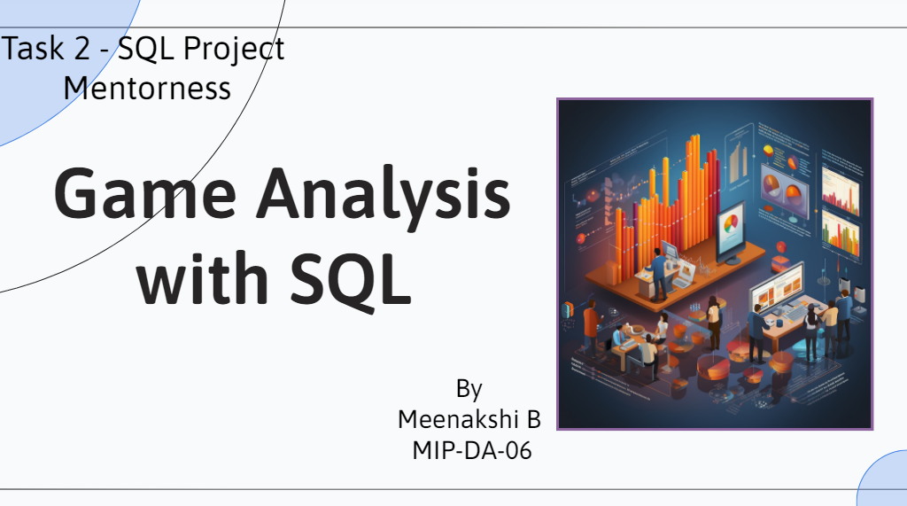

Slide 2


Slide 3
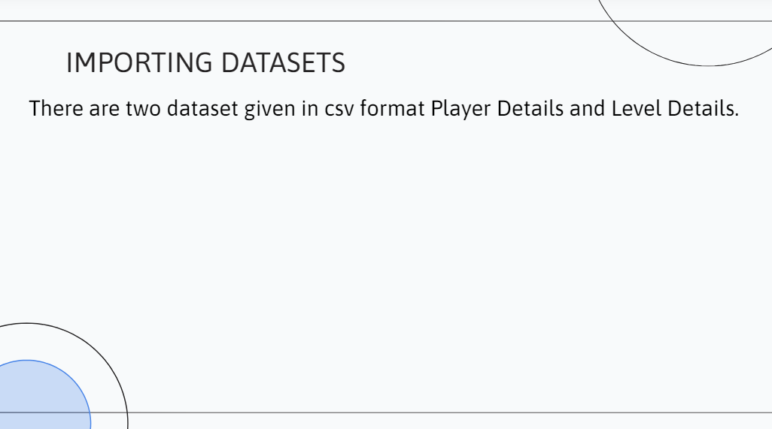
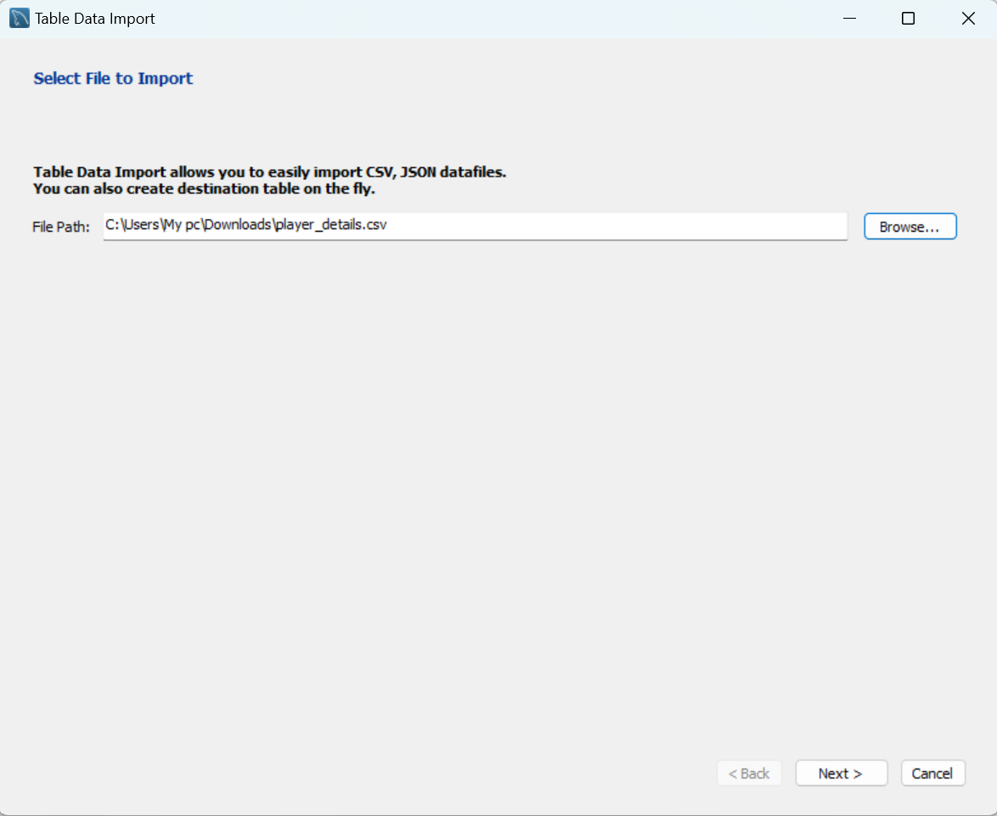
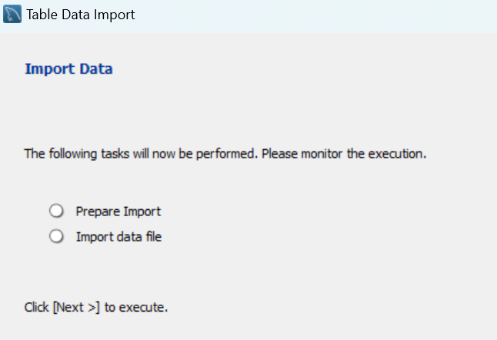
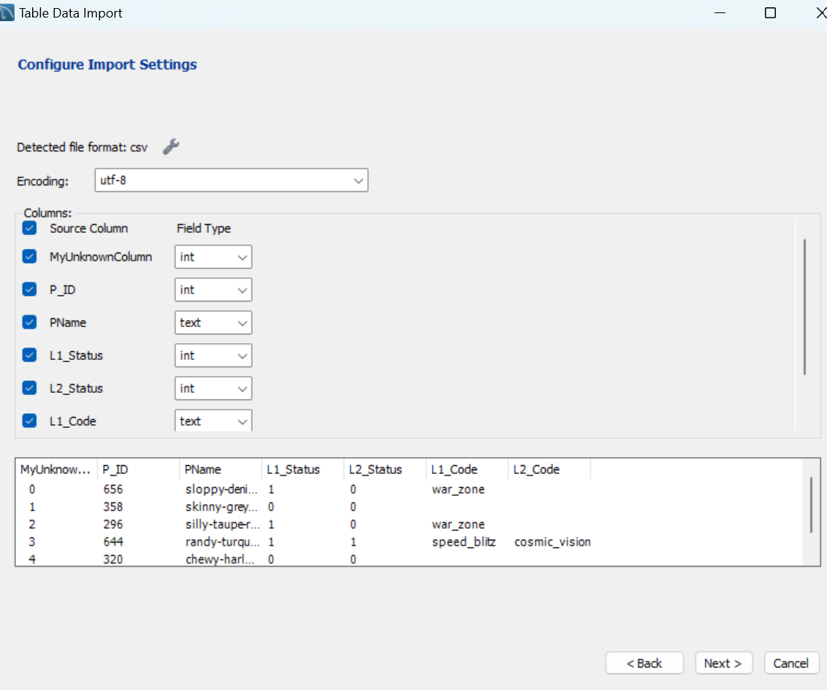

Slide 4
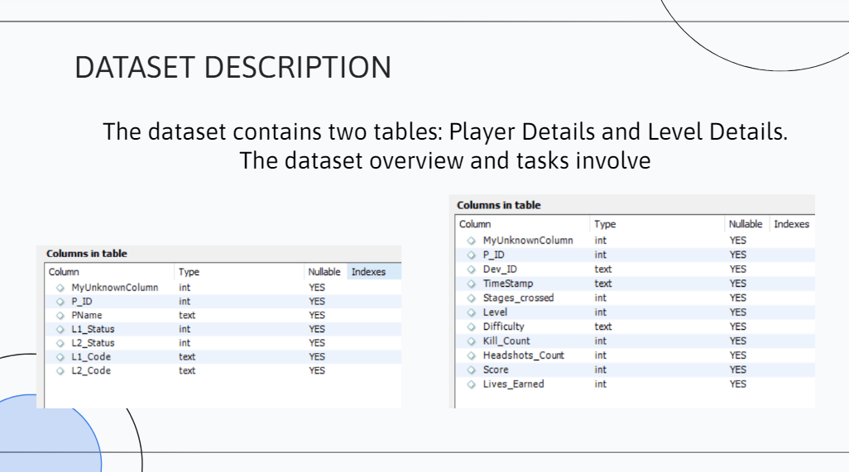

Slide 5
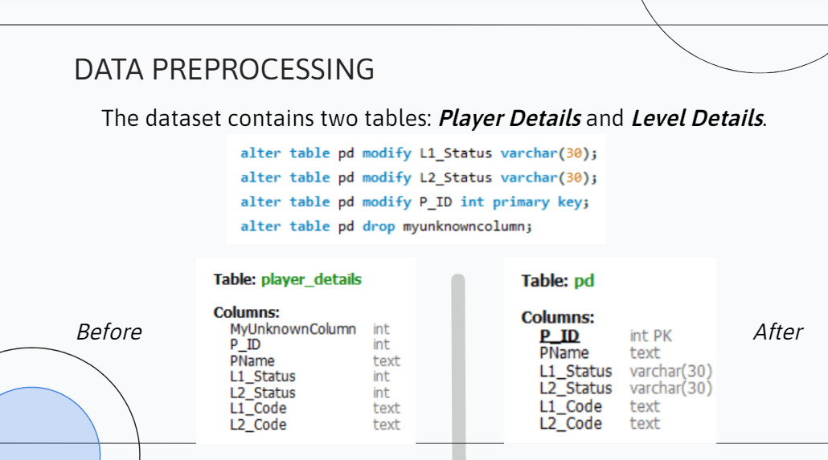

Slide 6
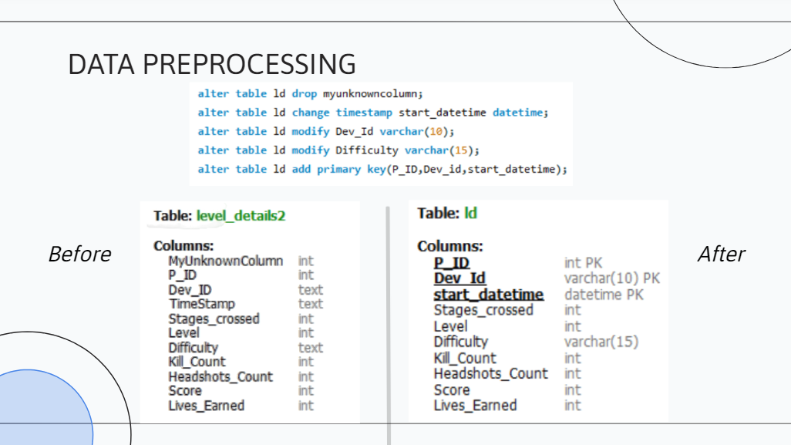

Slide 7
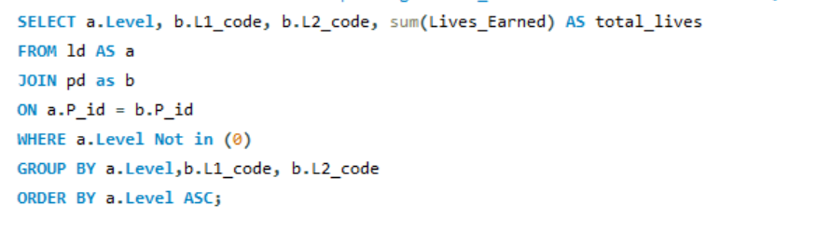
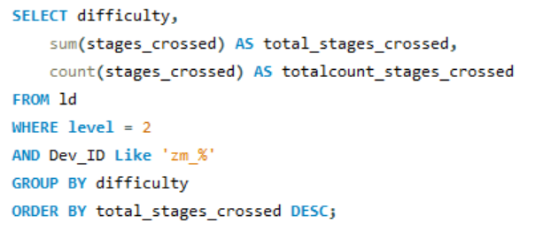
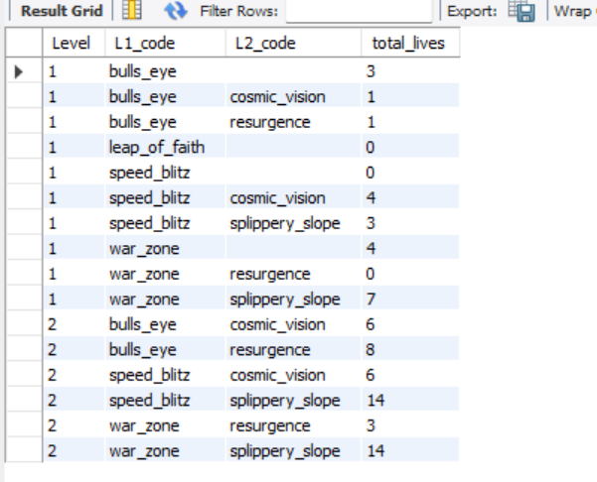
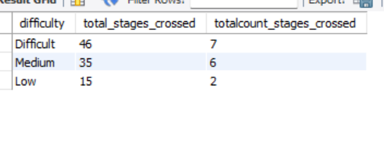
Find the total number of stages crossed at each difficulty level for Level 2 with players using `zm_series` devices. Arrange the result in decreasing order of the total number of stages crossed.-
Find `Level` and its corresponding `Level_code`wise sum of lives earned, excluding Level 0. Arrange in ascending order of level.

Slide 8

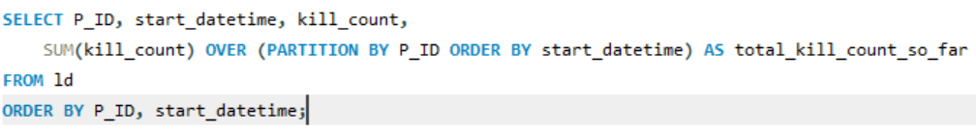
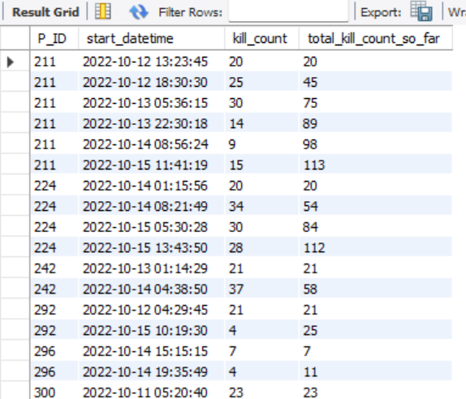
For each player and date, determine how many `kill_counts` were played by the player so far using windows functions

Slide 9
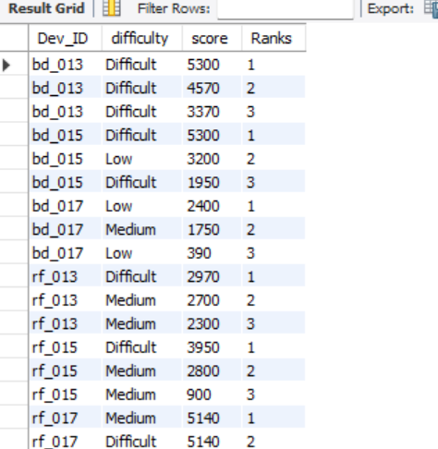
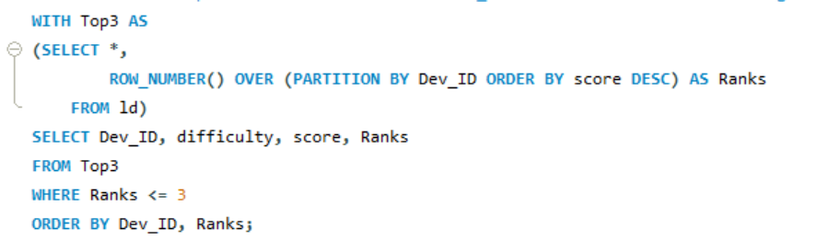
Find the top 3 scores based on each `Dev_ID` and rank them in increasing order using `Row_Number`. Display the difficulty as well.

Slide 10
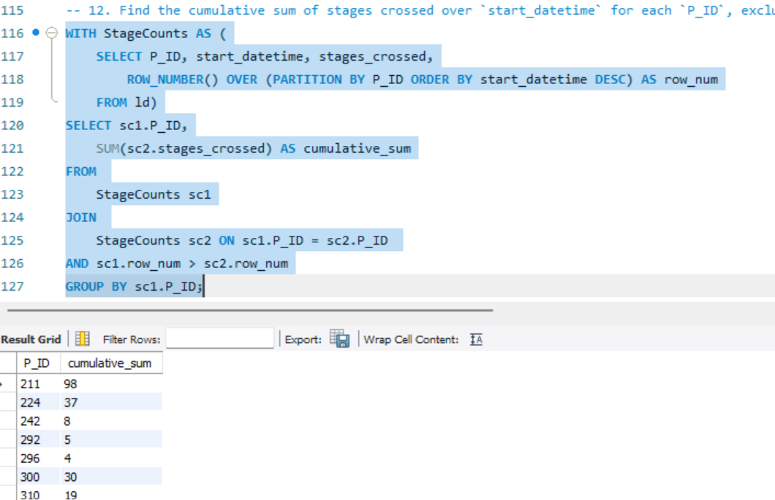
Find the cumulative sum of stages crossed over `start_datetime` for each `P_ID`, excluding the most recent `start_datetime`

Slide 11
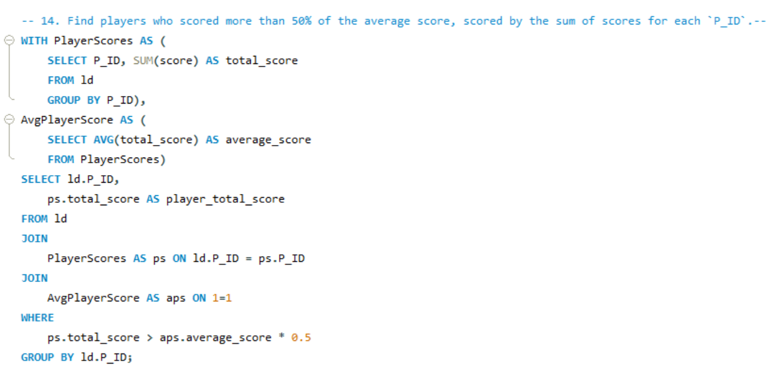
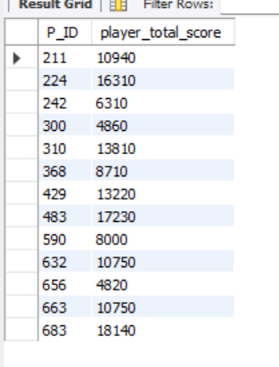
Find players who scored more than 50% of the average score, scored by the sum of scores for each `P_ID`

Slide 12

CONCLUSION
Adopting best practices in SQL analysis ensures accurate and reliable insights. This includes data validation, query optimization, and documentation for future reference.
SQL analysis offers a powerful lens into game performance and player behavior. By leveraging these insights, game developers can drive engagement, retention, and revenue growth.

Slide 13


